Slide 1

FRESHFLOW
Help building great products
Khushbu Gupta

Slide 2
Content
Problem
Opportunity
Revenue and profit
Competitor
Competitor Analysis Matrix
Pre-Product Launch Activities
Product Ideation to Launch
Video Walkthrough

Slide 3

PROBLEM
Distributed teams working on research and market understanding faces lot of challenges :
Collaboration
Coordination
Status updates
Missing Requirements
Processes and workflows
Documentation management

Slide 4
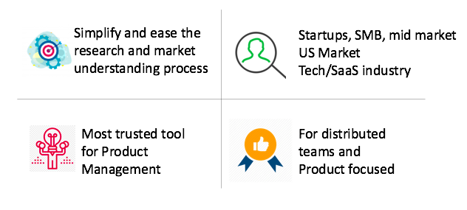
Opportunity
There are lot of project/task management tool available in the market which is generic and easily customizable as per user’s need. But our focus is specifically for startups and mid size companies for distributed teams who are developing a product from scratch.
This opportunity has lot of strength, potential and viability to make business. To start with, our initial focus will be simplifying market research process and later expand in other product management processes like idea validation, strategy development and testing.

Slide 5
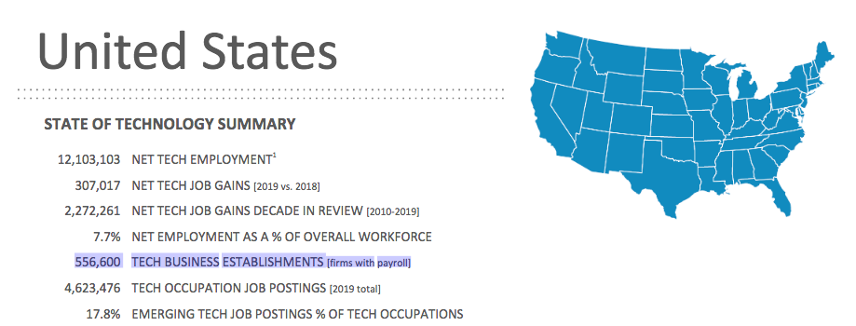
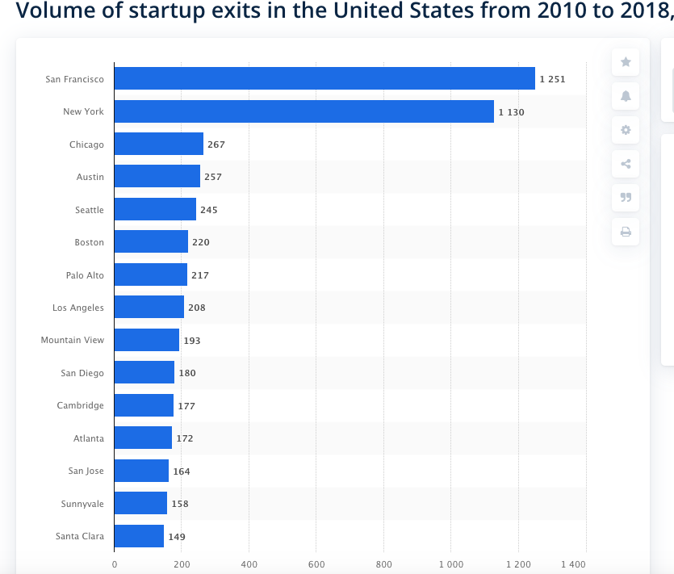
Opportunity
Total tech business establishment in US | 556,600+
Total number of tech startup in last decade in US | 5300+
Average revenue per user as per our basic subscription | $ 40
Total number of market users | 5300 * 150 = 795,000
Total Addressable Market | $ 31.8M
PS - Assumption: maximum 150 users per organization
No. of startups

Slide 6

Revenue and Profit
Development Team size | 2 (Dev + QA + UX)
Cost of each developer | $15 (Per hour)
Total time to develop - 1 month | 176 Hours
Development cost | $ 5280
Total Investment | $ 5280
Revenue per subscription | $40
User acquired | 79500 (10% of TAM)
Target paid user | 7950 (10% of users acquired)
Total Revenue = revenue per subscriber * number of paid user | $ 318 000
Net Profit = Revenue - Investment | $ 312,720

Slide 7



Competitors

Slide 8
Employee 380 | Revenue $ 85 M | Paid Customer 100,000
Website: monday.com
Founded in : 2012
Location: Israel
Mission: Make teamwork click. Anywhere.
Pricing: $79 / Year –Pro per user
Description: monday.com is a cloud-based Work OS, where teams create workflow apps in minutes to run their processes, projects, and everyday work.
SWOT
Opportunity: Remote working software for Work from home
Threats: Expensive for larger teams.
Weakness: Less focused on product management activities.
Strength: Task management and agile support

Slide 9
Employee 258 | Revenue $28.9 M | Paid Customer 24,000
Website: Teamwork
Founded in : 2007
Location: Ireland
Mission: To create the world's best productivity software
Pricing: $180 / Year Premium
Description: A suite of online collaboration tools designed to maximize your team’s productivity, communication and overall customer happiness. Project Management, Help Desk & Team Messaging software done right.
SWOT
Weakness: Not very user friendly
Opportunity: Improve on UX , UI and navigation for ease of use
Threats: Reporting is much better of other PM tools
Strength: Best for distributed team of any size

Slide 10
Employee 75 | Revenue $ 14.7M | Paid Customer 2500
Website: productboard.com
Founded in : 2014
Location: San Francisco
Mission: Get the right products to market, faster.
Pricing: $199 / year – 50 contributor
Description: Designed on the Product Excellence Methodology, productboard aligns everyone on the right features to build next and serves as the dedicated system of record for product managers.
SWOT
Weakness: Integration support with wide range and only web based
Opportunity : Expand to mobile apps
Threats : Challenge for distributed teams
Strength: Focuses on product management and road mapping

Slide 11
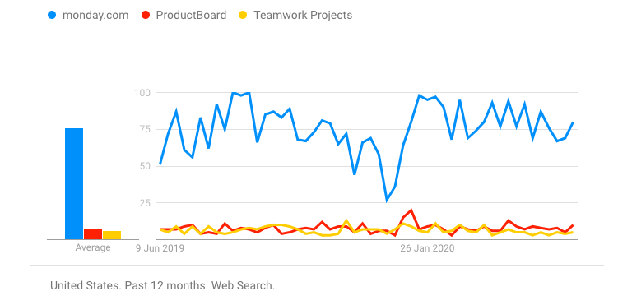
Competitor Analysis Matrix
 | Monday | Productboard | Teamwork
Typical Customer Type | S,M,L& Remote | S,M | S,M,L & Remote
Paid Customers | 100,000 | 2500 | 24,000
Pricing | Starts from $39/m | Starts from $49/m | Starts from $9/m
Revenue | $ 85M | $ 14.7M | $ 28.9M
Features | Manage project, resources, tasks and workflows | Product management solution from ideation to launch | Work and project management
Platform support | Web , Mobile | Web Only | Web , Mobile
Growth Rate:

Slide 12
Pre-Product Launch Activities
Prepare launch checklist
Plan go-to-market strategy
Prepare teams for launch
Sales
Marketing
Customer Support
Engineering
Dedicated support teams post Launch
Create promotional content for media launch

Slide 13

Product Ideation To Launch
Ideation
Development
Test marketing
Screening
Concept Testing
Research and Business Analysis
Commercialization

Slide 14
Video Walkthrough
Link to :
Freshflow Product Strategy Walkthrough

